Slide 1
Building Resilience
PB4L School-Wide conference 2017
Jenny.bauckham@education.govt.nz

Slide 2
BUILDING RESILIENCE
The greatest glory in living lies not in never falling, but in rising every time we fall
Nelson Mandela
https://www.youtube.com/watch?v=C1UCI2ZHEqw

Slide 3


Slide 4
Wellbeing is fundamental to student success and strongly linked to learning.
The role of emotion and emotional development in learning is well-founded, and it is now widely recognised that how students feel affects how they learn
  Durmont et al, OECD 2010
Notes:
How students feel affects how they learn
Listened to a well known broadcaster commenting on the reported high levels of anxiety that todays students were experiencing. His thoughts were that this was normal – a rough quote –kids get stressed doing exams, thats life!) . His approach is reflected in comments such as this

Slide 5
Harden up
Toughen up
Pull yourself together
Get over yourself
Kia Kaha
Notes:
Traditional methods of dealing with stress – helpful when you are anxious?
Need to know -
How to I harden up
How to I toughen up
How can I pull myself together and get over this
How can I be strong
She had lost the ability to bounce back

Slide 6

Physical fitness is the speed in which one recovers from physical stress
Resilience is the speed with which you can bounce back from psychological stress
Notes:
Taking this analogy a step further
If we are physically very fit and get injured we recover quickly from an injury. However if we have been inactive and injure ourselves doing physical activity it takes a lot longer to recover
It is the same thing with the resilience if we have a level of resilience already the quicker we ‘bounce back’ from stress, anxiety or bad times. So what makes us resilient (next slide)

Slide 7
WHAT IS RESILIENCE?
Resilience is the ability to get up off the ground, brush yourself off, and keep moving on.
It’s also when you can handle stress and hard times in life.
It is also the ability to become strong, healthy, or successful again after something bad happens
Notes:
Last line – No matter how wonderful our lives are BAD THINGS HAPPEN and our ability to brush ourselves off .

Slide 8
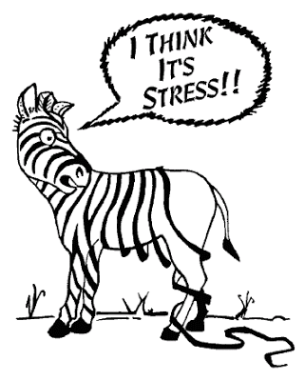
Resilience is more accessible and available to some people than for others, but everyone can strengthen their resilience.
Notes:
The good news
We can all strengthen are resilience – build it up and bounce back

Slide 9
A number of factors contribute to how well people adapt to adversity
Having caring and supportive relationships within and outside the family
The capacity to make realistic plans and take steps to carry them out
A positive view of yourself and confidence in your strengths and abilities
The capacity to manage strong feelings and impulses
Notes:
Relationships that create love and trust , provide role models, and offer encouragement and reassurance help bolster a persons resilience.
Even with them there are times that are difficult – example of role on effect – grief, anxiety – unable to manage strong feelings impacts on positive view, which prevents ability to carry out plans etc.
Without these, need to work harder to build up the ability to draw on strategies and skills for resilience.

Slide 10
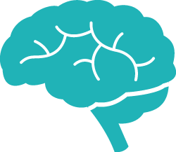
Skills and
strategies
Building
Resilience
LEARNING
LIFELINE
Obstacles
and
challenges
Notes:
So what we want to do (our goal) is to keep building our resilience so we can make the most of opportunities presented to us and bounce back quickly from set backs.
Ideally we always want to be above the line but as our journey get a bit bumpy we sometimes sink a bit below the line. The reason the brain is in the middle is we can think about our set of resilience skills as learning to ‘drive our brain’. (There’s also other things to deal with eg/ biological brain develpment etc).
Ideally we always want to be above the line but as our journey get a bit bumpy we sometimes sink a bit below the line. The reason the brain is in the middle is we can think about our set of resilience skills as learning to ‘drive our brain’. (There’s also other things to deal with eg/ biological brain development etc).

Slide 11
Cognitive Behavioural Therapy
CBT
Hands on, practical approach to problem-solving.
Its goal is to change patterns of thinking or behaviour that are behind people’s difficulties, and so change the way they feel
Notes:
Resilience and CBT go hand in hand

Slide 12
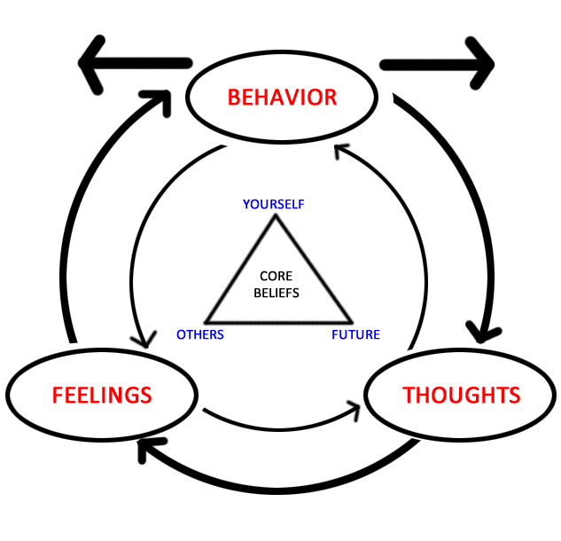
Notes:
The diagram depicts how emotions, thoughts, and behaviours all influence each other. The triangle in the middle represents CBT’s tenet that all humans’ core beliefs can be summed up in three categories: self, others, future.
Steering wheel --... If we feel good about our self, others and our future ... We have good thoughts, we feel good which impacts on our behaviour. When we behave the way we want, we have good thoughts, feeling and feel good about our self, others and our future.
The opposite also applies – bad beliefs etc. Goes around and around and the cycle needs to be broken

Slide 13
Skills and Strategies
Mindfulness and Attention Training
Challenging Unhelpful Thoughts
Notes:
Learn to be mindful: We hear, we see, we feel and we think constantly though out the day. (Hold hand up for silence – quick answer “what can you hear” now close your eyes –listen – ten seconds what do you hear. Mindful attentive – imagine if you took that time to enjoy a moment (in the garden, having dinner with people you enjoy and love, eating a meal etc)
Helpful thoughts/unhelpful thoughts – learn to identify them and restructure them. Negative thoughts increase when things are not going well and ‘in a bad space’ compounding the problem. For young people this technique is the most effective in helping overcome fears and anxieties. For adults, having the ability to scrutinise their self talk will make them much more resilient to deal with th personal challenges faced as transition into old age

Slide 14


Slide 16


Slide 17


Slide 18


Slide 19
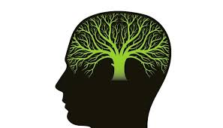
Growth mindset
In a growth mindset, people believe that their most basic abilities can be developed through dedication and hard work – brains and talent are just the starting point. This view creates a love of learning and a resilience that is essential for great accomplishment.
https://www.youtube.com/watch?v=aNWA3ZwJdLk
Notes:
3 minutes long

Slide 21
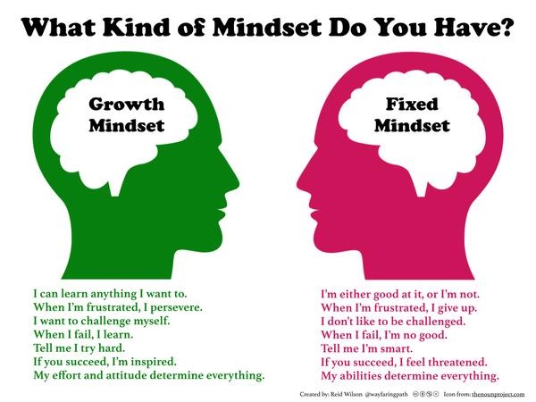

Slide 22
Skills and Strategies
Mindfulness and Attention Training
Challenging Unhelpful Thoughts
Identifying Role Models and Support Networks
Problem Solving Strategies
Assertive Conflict Resolution
Notes:
Role models - people who possess desirable characteristics that we strict to replicate in our own lifes people who motivate you, who lift you up – aspirational ; Individual people provide different support.
Problem Solving Strategies – Breaking down the problem, brainstorming the options, thinking of the consequences of each option – choosing the best option. Its about . Talking to others
Assertive rather than aggressive or passive dealing with conflict in a positive way,- listening to others, empathy, understanding your own thinking, expressing your opinion ina positive way being prepared to compromise.

Slide 23
Awareness of neurological development
In adults, various part of the brain work together to evaluate choices, make decisions and act accordingly in each situation.
The teen age brain doesn't work like this.
Notes:
Sometimes teenagers do things that seem completely out of character – those “What were you thinking “ moments

Slide 24
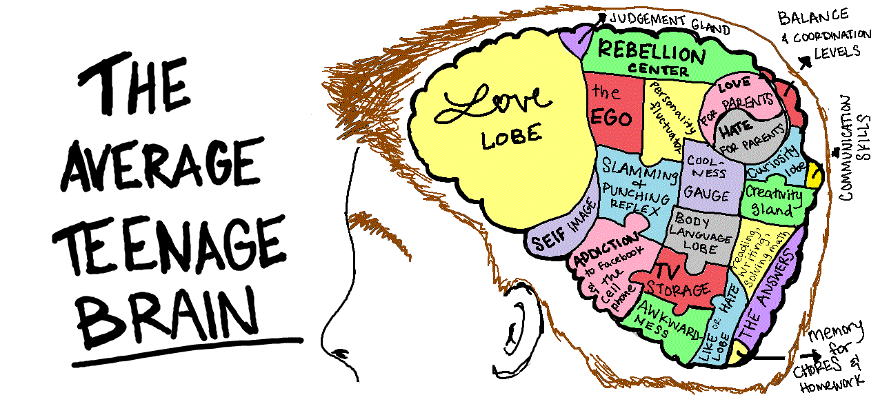

Slide 25
The prefrontal cortex is the last part of the brain to mature and it guides complex processing of information including decision making, controlling impulses, anticipating consequences of behaviour and the ability to take in information and understand it, then set goals and plan
Notes:
Think of it as an entertainment centre that hasn’t been fully hooked up.
There are loose wires, so that the speaker system isn’t working with the DVD play, which in turned hasn’t been formatted to work twit the television yet. And to top it all off, the remote control hasn’t arrived!
The remote control is the prefrontal cortex – a section of the brain that weights outcomes, forms judgements and controls impulses and emotions. This provides an opportunity to teach approaches and strategies for students to draw on in.
Without this full control young people are vulnerable to making bad decision, anxiety and depression

Slide 26
Professor Sir Peter Gluckman: Youth Suicide in New Zealand .... ... “that youth suicide is more than simply a mental health issue and that, with what we know at present, the focus must also include an emphasis on primary prevention starting from very early in life. This means promoting resilience to the inevitable exposure to emotional stresses and building self-control skills in early childhood and primary years”

Slide 27
WHY PROVIDE RESILIENCE TRAINING
Anxiety disorders are the most common mental health disorder amongst children and adolescents
Almost one in five young New Zealanders meet the criteria for an anxiety disorder by age 19. Of those that would benefit from intervention, over 80% are untreated

Slide 28
Why provide resilience training
Maori and Pasifika young people are at comparatively high risk of mental health problems, and have particular barriers to accessing services
Youth living with mental health conditions are more likely to leave school early with poorer education outcomes and lower than their potential

Slide 29
Schools can provide protective influences that enhance and promote resilience through the development of social and emotional learning
Schools are ideal setting for building mental health resilience
Notes:
Introduce Julie-Anne who will discuss a school-wide approach to building resilience

Slide 30
A School-Wide Approach to Building Resilience and Well-being

Slide 31
School -Wide
School Culture/Traditions
Organisation/Routines
Curriculum
Well-being of staff and students
Explicit teaching of the skills and strategies
Consistent Teacher Practise
Support Systems
Community and whanau

Slide 32
School Culture/Traditions
Being connected and belonging
The importance of engaging students in the school community so they feel they belong and are valued.
Whole school events
Extra-curricular activities
Group building
Clear expectations
Reinforcement of positive behaviour

Slide 33
School Organisation/Routines
Orientation of new staff and students to the school
Food- breakfast clubs, lunch programmes
Exercise-daily
Safe environment
Appropriate break times
Clear behaviour expectations
Consistent classroom routines
Consistent behaviour management
Assessment planning to ensure students are not overloaded

Slide 34
NZ Curriculum
Vision Statement
Confident. Connected, Actively Involved
Lifelong Learners
Values
Excellence
Pages 8/10 NZC

Slide 35
NZ Curriculum
  Key Competencies
Managing self- students who manage themselves are enterprising, resourceful, reliable and resilient
PARTICIPATING and contributing- sense of belonging and the confidence to participate within new contexts
Page 12/13 NZC

Slide 36
Health and Physical Education
Health education-Students build resilience through strengthening their personal identity and sense of self-worth, through managing change and loss, and through engaging in processes for responsible decision making.
Students learn to demonstrate empathy, and they develop skills to enhance relationships.
Page 22/23 NZC

Slide 37
Well-Being of Staff
How can schools support staff to be resilient? E.g. Clear expectations , realistic timelines for deadlines, support when coping with difficulties, team building and staff to feel they belong and are valued .

Slide 38
Explicit teaching of the skills and strategies to be resilient
Timetabling
Staff Professional development
Planned units of work
Use data to inform teaching

Slide 39
Consistent Teacher Practise
All students are taught these skills and strategies appropriately throughout years1-13
Reinforcement of strategies and skills in all classes.
Consistent language used by all teachers/staff
Inclusive

Slide 40
Support Systems
Clear readily accessible processes and support for students and whanau.
Links to community organisations who provide appropriate support for students and whanau.

Slide 41
Community and whanau
Good communication
Feeling a valued members of the school community
Support available when needed
Whanau education on how to support their children to be resilient

Slide 42
Next Steps: Resilience in New Zealand schools
Help young New Zealanders learn the knowledge and strategies to cope with every day challenges of life now and in the future.

Slide 43
My FRIENDS Youth Resilience programme
As part of the Prime Minister’s Youth Mental Health Initiative the Ministry conducted a 3 year trial of My FRIENDS Youth Resilience programme to Year 9 students from 2013 to 2015 involving 40 secondary schools
Notes:
The New Zealand Council of Educational Research were contracted to evaluate how My FRIENDS Youth met the needs of NZ students and how effective a resilience programme is in improving students social and emotional literacy, to build resiliency.

Slide 44
Learnings from the evaluation
There is a demand for a classroom based resilience programme
Teaching cognitive behaviour theory (CBT) strategies and skills fits well with the New Zealand curriculum and Health and Physical learning area , of which mental health is a key element.
Notes:
The success

Slide 45
A resilience programme to be fit for purpose for New Zealand schools
Able to be taught in 10-12 modules to ensure that the programme is taught in its entirety
Incorporate students need for ongoing reminders about the approaches and strategies
Provide opportunities for experiential learning and practical activities to increase student engagement
Be compatible with and a fit for the New Zealand cultural and educational context.
Notes:
What we learnt and was also recommended by NZCER that this was needed to make a programme fit for purpose for NZ. Working with our pilot schools we realised that we had the capability to design a New Zealand resilience programme encompassing the curriculum and working with New Zealand students to ensure it was engaging

Slide 46

The evaluation report confirms that for a resilience programme to be fit for purpose for New Zealand schools it needs to be:
  Able to be taught in 10-12 modules to ensure that the programme will be taught in its entirely
  Incorporate students need for ongoing reminders about the appoaches
  Provide opportunities for experiential learning and proactical activies to increase student engagnement
Opportunity

Slide 47
Mental Health Package – improving learning environments and build resilience (August 2017)
Initiative Summary
Building resilience in children and young people leads to positive social behaviour, improved mental wellbeing, and increased educational achievement.
Strategies to increase resilience and improve the wellbeing of children and young people are most effective when they are part of a whole-school focus on a positive school culture and learning environment.
The Positive Behaviour for Learning (PB4L) School Wide programme has built some capability in this area but does not include an explicit focus on resilience.
Notes:
As you can see this is a very new release. Still working out the process of what will be done and how it will be done .
However it is a great opportunity to build on a School-Wide approach and develop resilience and social emotional learning for all students across all schools. (not for a particular year ie Year 9)

Slide 48
Key points
Will create a universal approach to improve learning environments and build the resilience of students
High priority for the Minister and the Ministry
Evidence is important (self-control)
Engage with schools to ensure it works for students and teachers
Will take an evaluative approach
.
Notes:
The Mental Health Package totals $100 million. 60% of this funding will go on supports for children and young people

